Slide 1

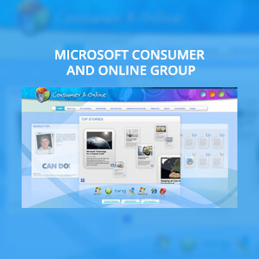
Microsoft Consumer and Online Group – SharePoint 2010 Migration
The Challenge
<p>Microsoft Consumer and Online Group needed a centralized place to manage Microsoft&rsquo;s entire consumer-facing plans. They were concerned about growing support costs and also wanted a highly functional site with a design that would be representative of their new strategic direction.</p>
<p>Frustrated with prior vendor engagements, C&amp;O asked Affirma for expert SharePoint consulting and for help with their SharePoint 2007 to SharePoint 2010 migration.</p>
What We Did
<ul>
<li>Affirma created a new Silverlight-based interactive experience feeding dynamically off of SharePoint list data; we also architected and structured information to optimize users&rsquo; ability to find what they need quickly to get work done.</li>
<li>We focused on improving User Experience and Design by creating an elegant interface to surface information in a unique and interactive way.</li>
<li>Enterprise Social Media&ndash; Employee profiles were surfaced via Bing Maps to create an effective, contextually relevant enterprise social media experience.</li>
</ul>
Results
<p>Affirma focused on Design, Interactivity and User Experience in this SharePoint Consulting project. The resulting site was consistent with the division&rsquo;s new strategic direction, provided an engaging experience for end-users, was seamlessly integrated with SharePoint 2010 and ultimately achieved the business goal of lowered support costs. The client was very pleased with their new portal.</p>

